Slide 1
Simulating Learning in Generated Environments
Austin Barner, Vihan Garg, Zakk Loveall

Slide 2
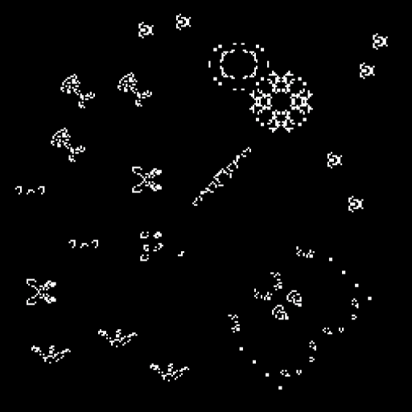
Background
Wanted to simulate creatures in environments
Similar to Conway’s Game of Life
Needed to break our problem into pieces
Realized one goal was creature behavior
Movement algorithms
Another goal was world generation
Creatures need environments to traverse
Learning to traverse unique environments

Slide 3
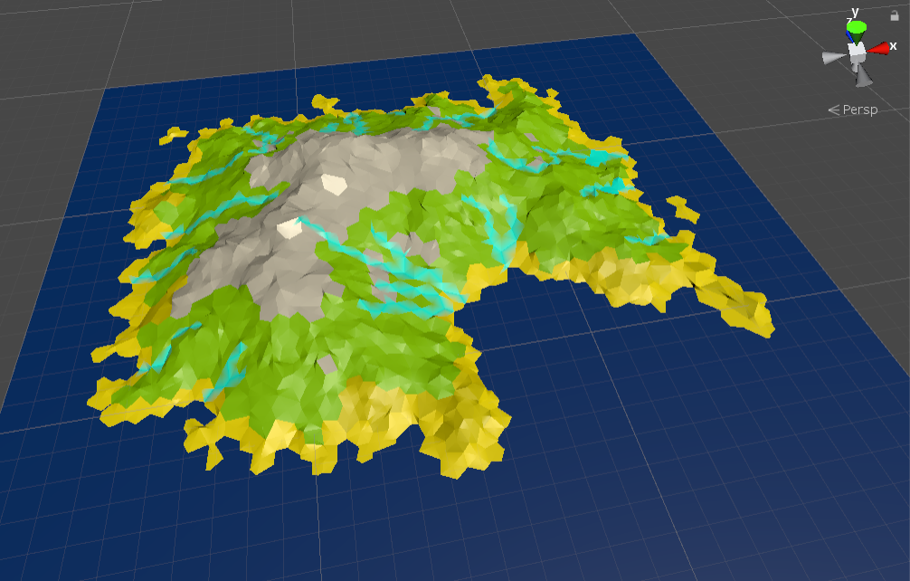
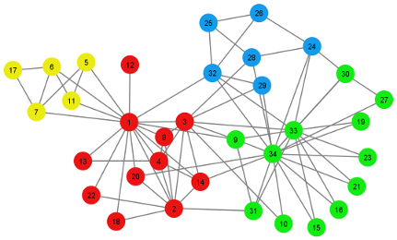
Implementation
Decided on Unity to do our project
Provides UI
A lot of resources
Split our project into two parts
World generation
Mimic an actual environment
Meaningful movement behavior
Mimic creature learning

Slide 4
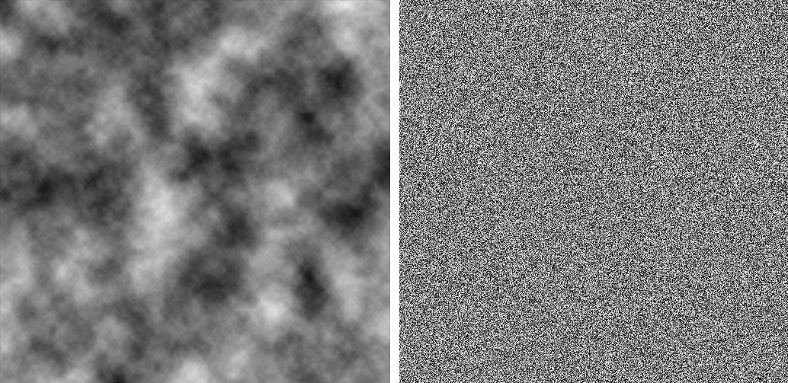
World Generation
Utilize Open Simplex Noise
Derived from Perlin Noise
These algorithms allow for ‘natural’ looking terrain generation
N-dimensional
Pseudo-random
Seed-based
These algorithms are commonly used in video games
Minecraft
Example perlin noise vs random noise map:
Image source: https://brandenstrochinsky.blogspot.com/2015/05/random-map-generator.html

Slide 5
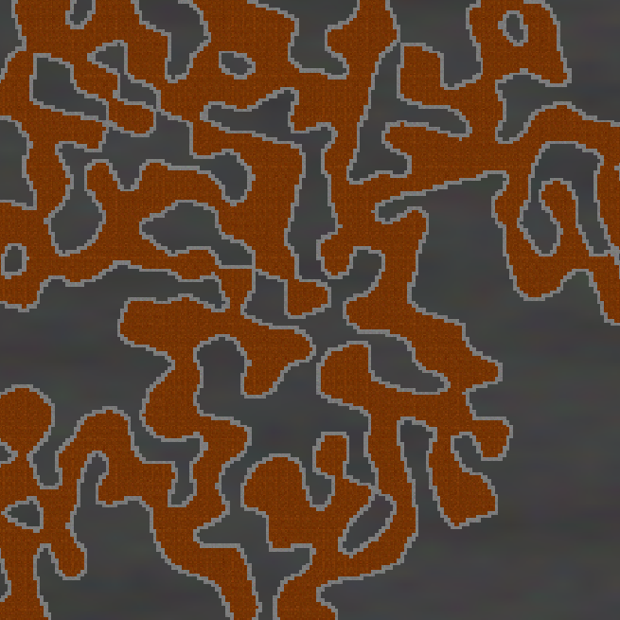
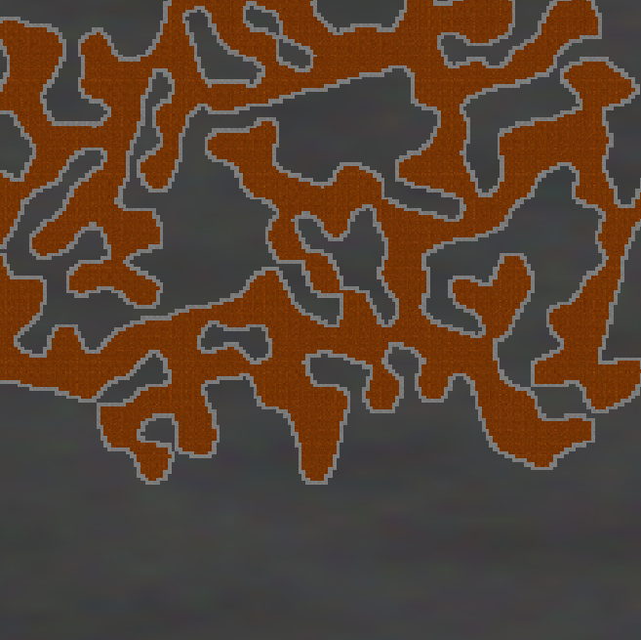
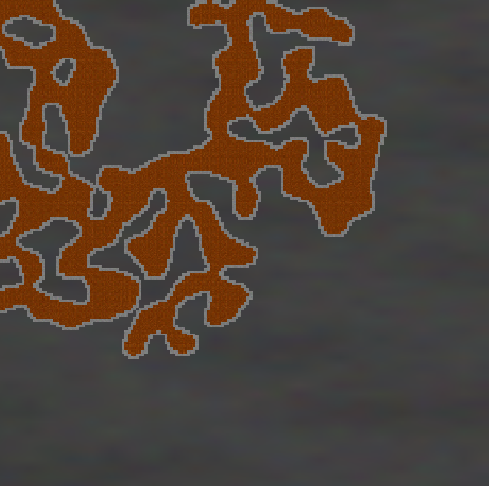
World Look and Feel
Seed: 1805235358
Seed: 317055230
Seed: 564933020
Open Simplex Noise Algorithm: https://gist.github.com/digitalshadow/134a3a02b67cecd72181

Slide 6
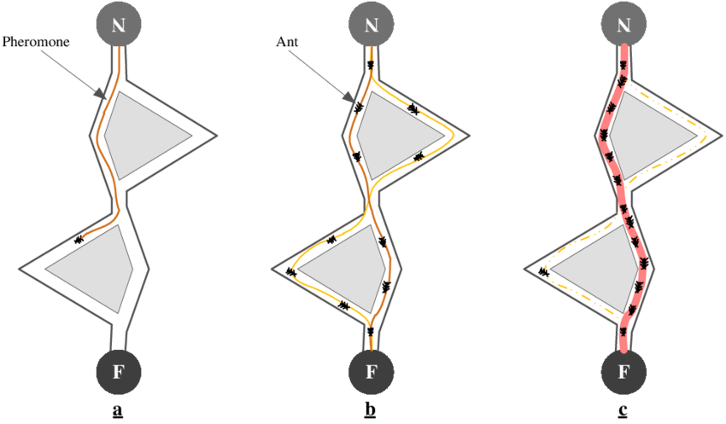
Movement Algorithm
Goal was to simulate learning
Ant Colony Optimization
Simulate learning behavior
Good for finding paths through graphs
Our terrain was a glorified graph
Give the ants food source to work towards

Slide 7
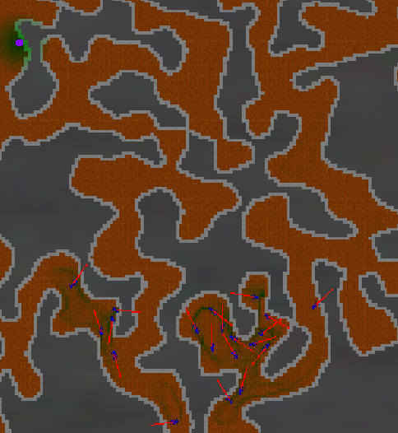
Steps for Implementation
Drop Pheromones
Pheromone strength associated with tile
Dual pheromone system
Avoid clustering
Encourage exploration
Following pheromone trails
Ants will follow pheromone trails
Alpha evaporate over time
Find Food
Use alpha pheromone trail for food location
Use beta pheromone trail to determine density
Image was cropped

Slide 8
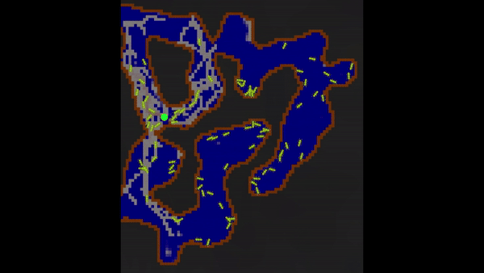
Ant Movement Demonstration
Green Dot - Food
Red Tile - Alpha Pheromone
Blue Tile - Beta Pheromone

Slide 9
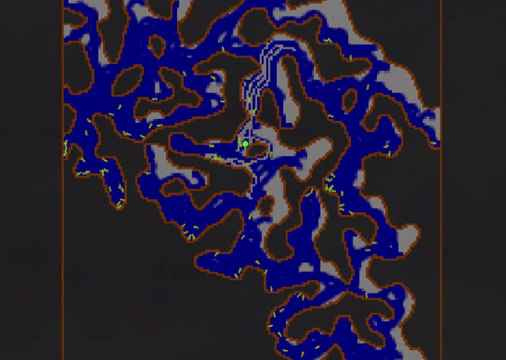
Challenges
Team Challenges
Defining scale/scope
Finding best solution to problem
Agreeing on ideas
Search Algorithms
A* search algorithm
Neural network based learning
Genetic learning
Many issues with these
Too simple
Too complex
Not applicable

Slide 10
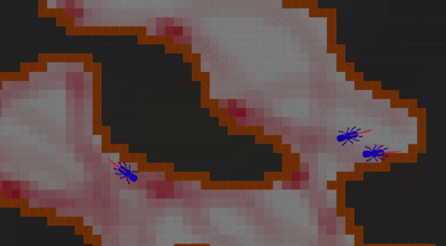
Future Work
Learning-based simulations
Potential games to be made
Tower defense games
A life simulator game
More complex behavior
Fighting or foraging
More complex creature structure
Evolves based on weak points
More complex environments
Add water or trees
Completely fix clustering problem
Improve beta pheromone handling

Slide 11
Conclusions
Learned a lot
Compromise
Trial and error
We can mimic evolution-based learning
Ants were able to follow pheromone trails to food
Our generated environment did work
Environment simulated what we wanted it to

Slide 12
Sources:
http://www.ludowaltman.nl/slm/
https://gamedev.stackexchange.com/questions/173190/how-to-make-procedurally-generated-terrain-look-realistic
https://www.geeksforgeeks.org/search-algorithms-in-ai/
https://en.wikipedia.org/wiki/Ant_colony_optimization_algorithms
https://experiments.withgoogle.com/conway-game-of-life

Slide 13
Questions?

